Slide 1
Web Programming
Lecture 7
Javascript - 3
Callbacks, Promises, Async/await, Eventloop
Mahhek Tahir
Notes:
.

Slide 2
Callbacks
A callback is a function passed as an argument to another function. This technique allows a function to call another function
function calculate(a, b, callback) {
let result = callback(a, b);
console.log("Result:", result);
}
function add(x, y) {
return x + y;
}
calculate(5, 3, add);

Slide 3
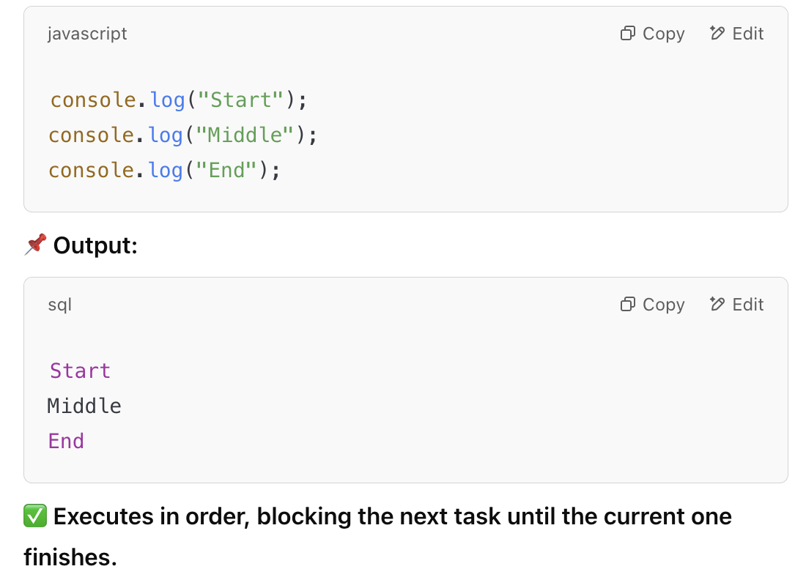
Asynchronous
JavaScript is single-threaded, meaning it executes one task at a time. However, asynchronous programming allows it to handle multiple tasks without blocking execution.
Synchronous Code
(Executes One Task at a Time)

Slide 4
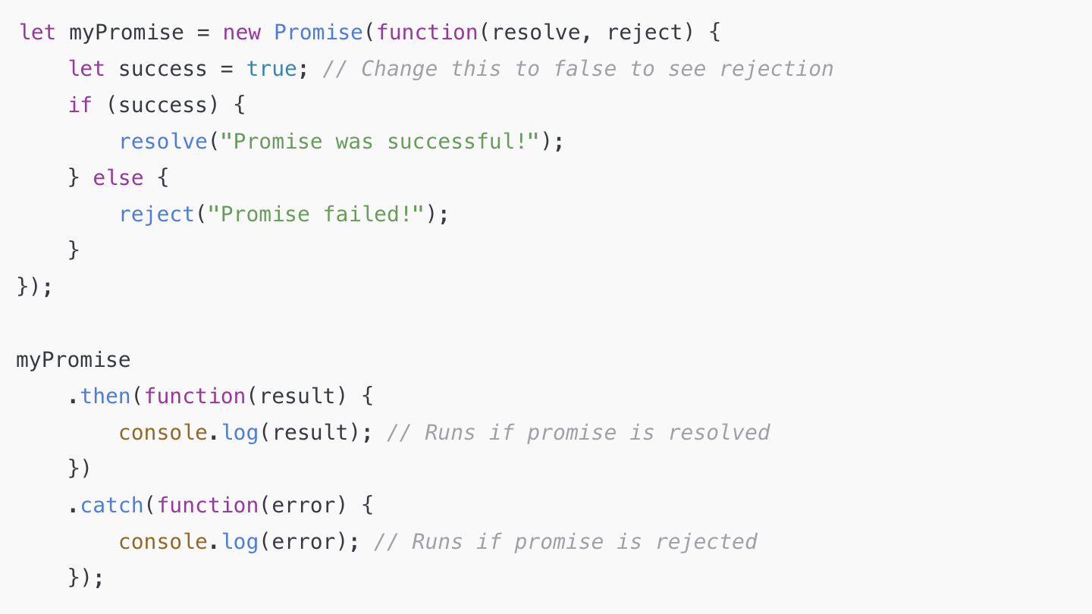
Promises
Represent a future value (success or failure).
States: Pending → Resolved / Rejected.

Slide 5
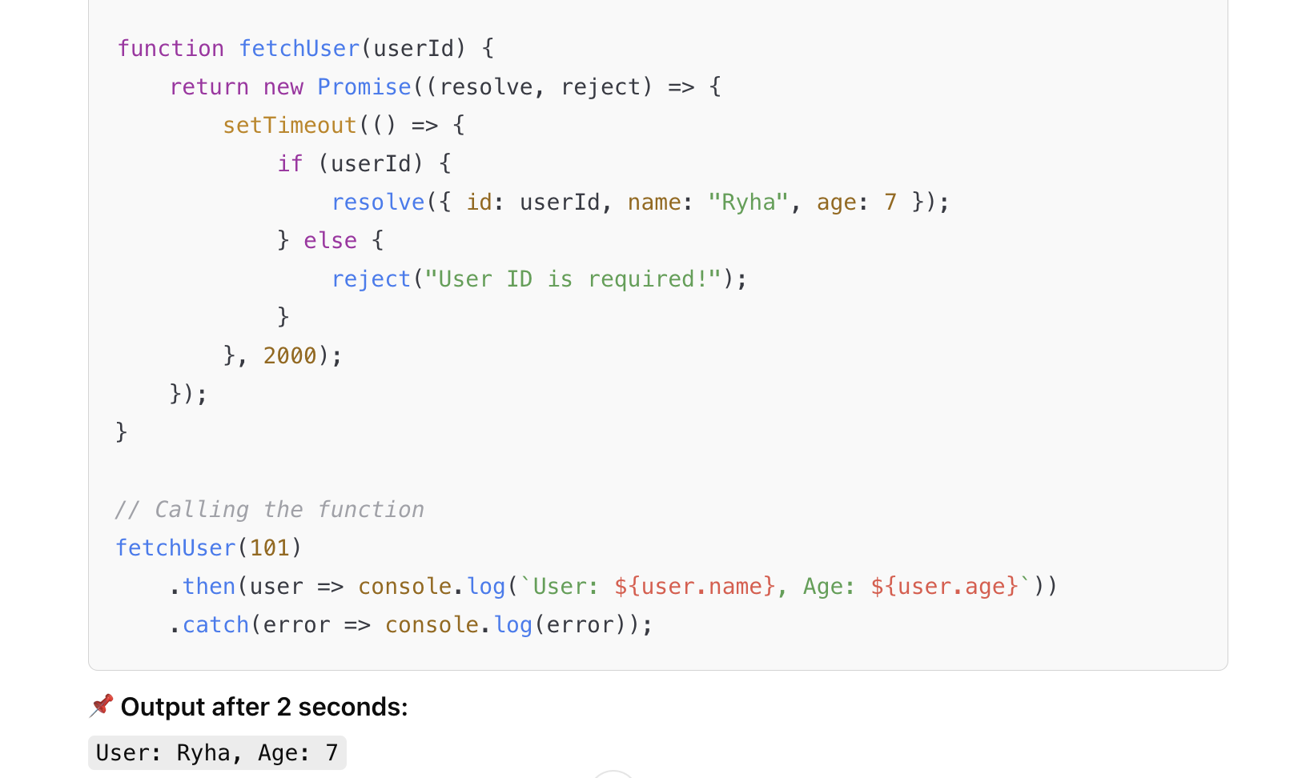
Promise - to check for ID

Slide 6
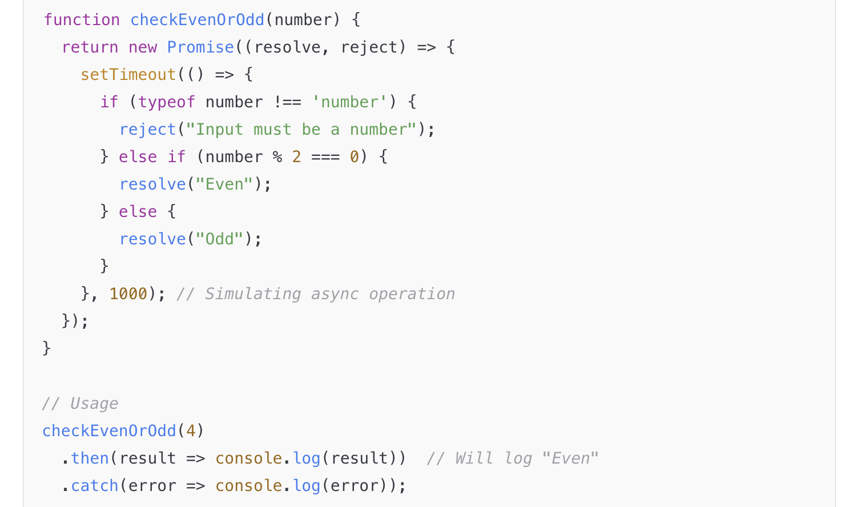
Promise - a use case to check even or odd

Slide 7
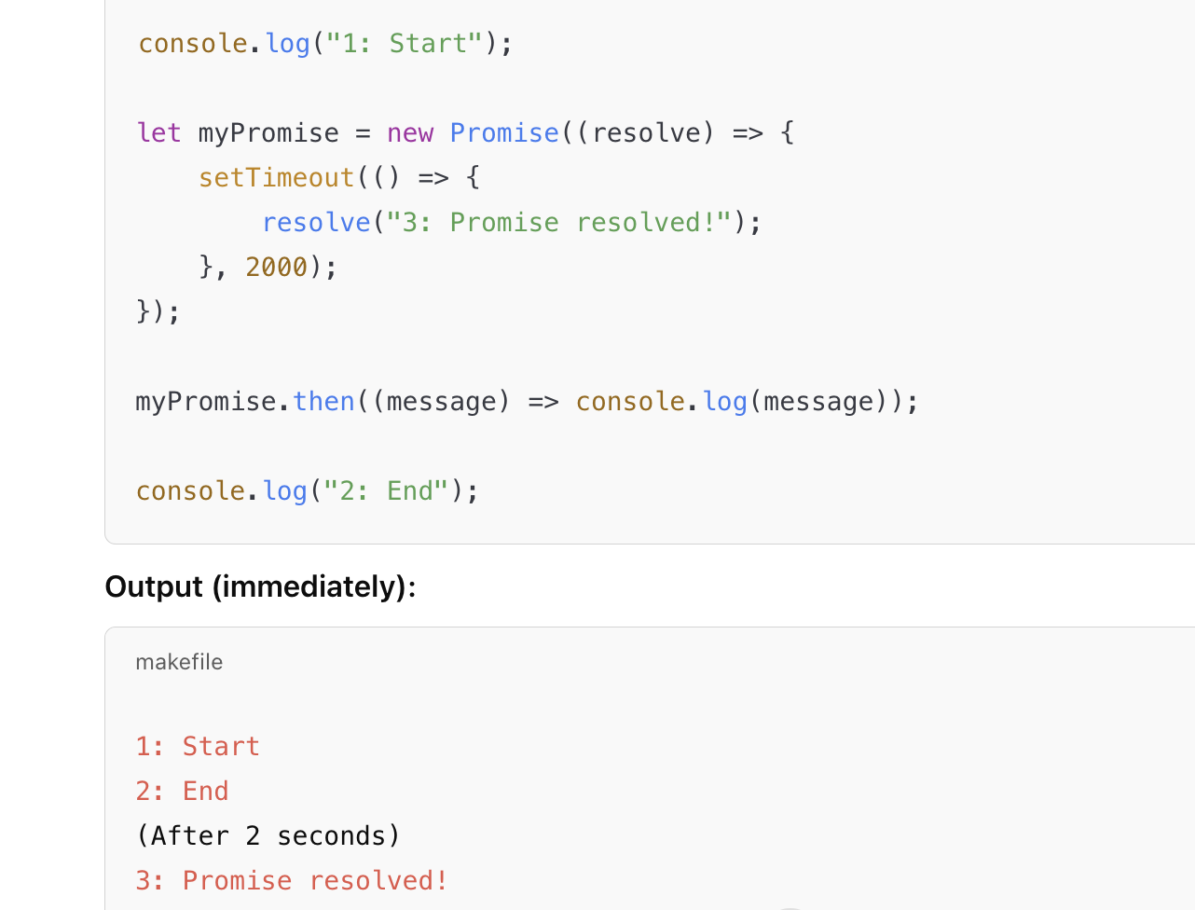
How is promise Asynchronous

Slide 8
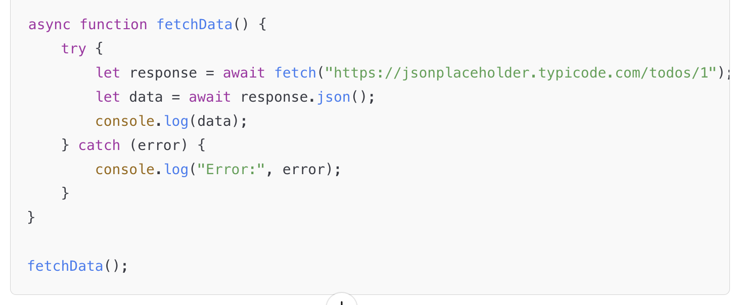
Async/Await
Makes async code look synchronous.
Uses try...catch for error handling.

Slide 9
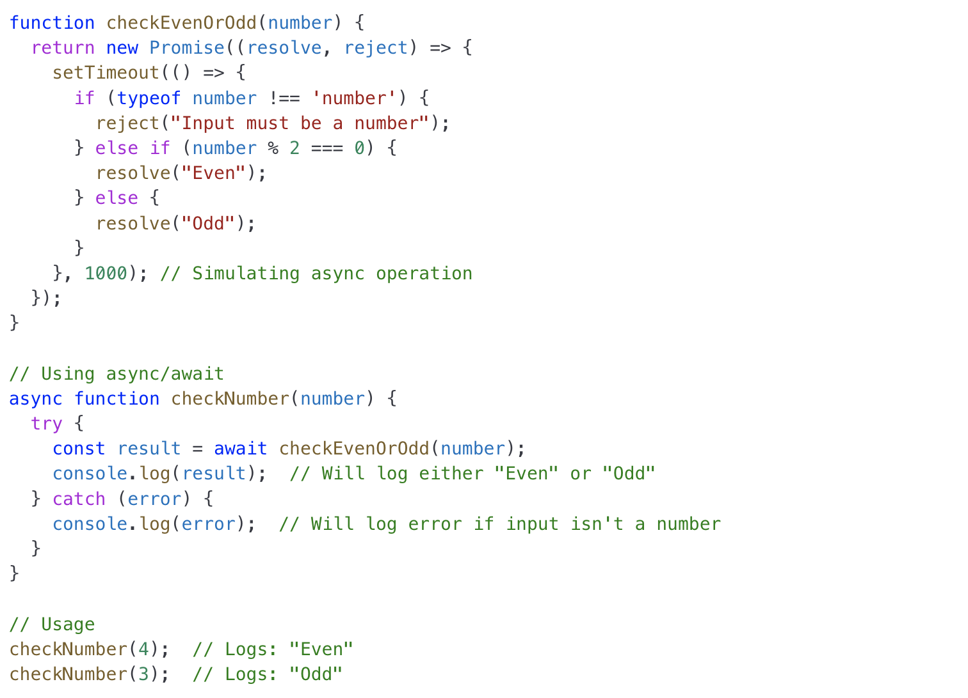
Async/Await - a use case to check even and odd numbers

Slide 10
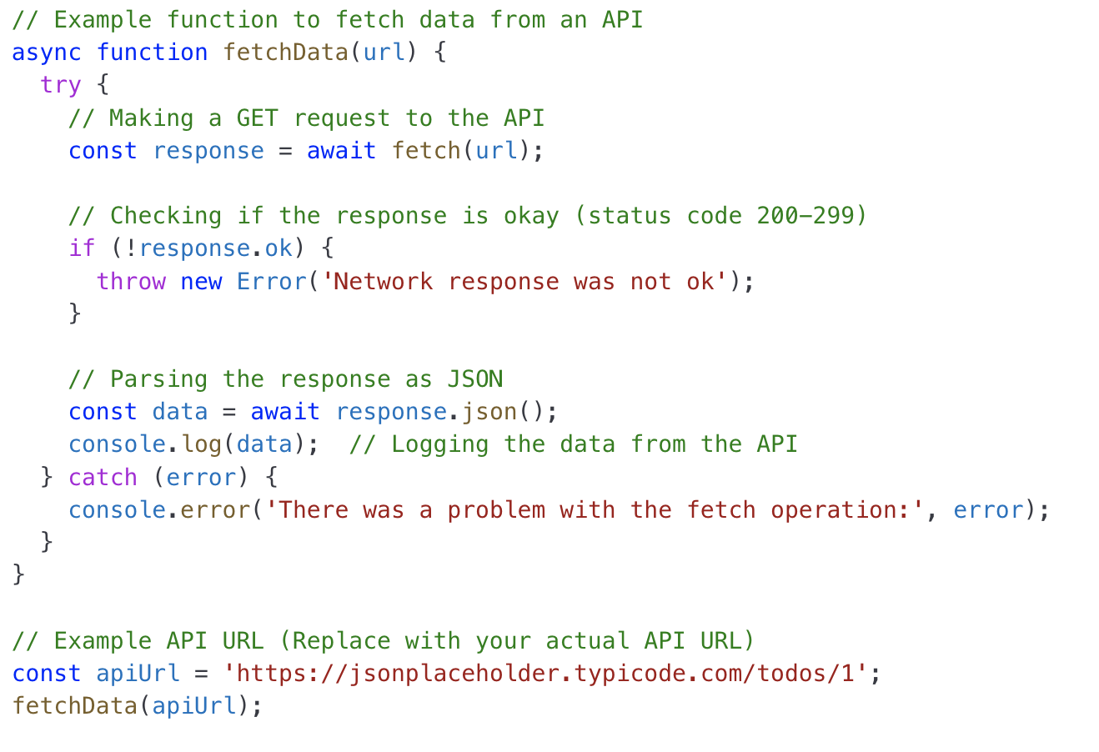
Fetch api using JS

Slide 11
Event Loop
When the fetch api completes asynchronously (outside of main thread), it then calls the callback passed in the then. But is the execution of callback started immediately?
The callback is actually placed in a queue.
When the javascript thread is free, it takes a task from the task queue and executes it.
The Event Loop is what makes JavaScript asynchronous. It allows JavaScript to handle non-blocking operations, even though it's single-threaded.

Slide 12
How Does Event Loop Works?
JavaScript has:
Call Stack → Handles function execution (one at a time).
Web APIs → Handles asynchronous tasks (like setTimeout, fetch).
Callback Queue → Stores completed async tasks waiting to run.
Event Loop → Moves tasks from the Callback Queue to the Call Stack when it's empty.

Slide 13
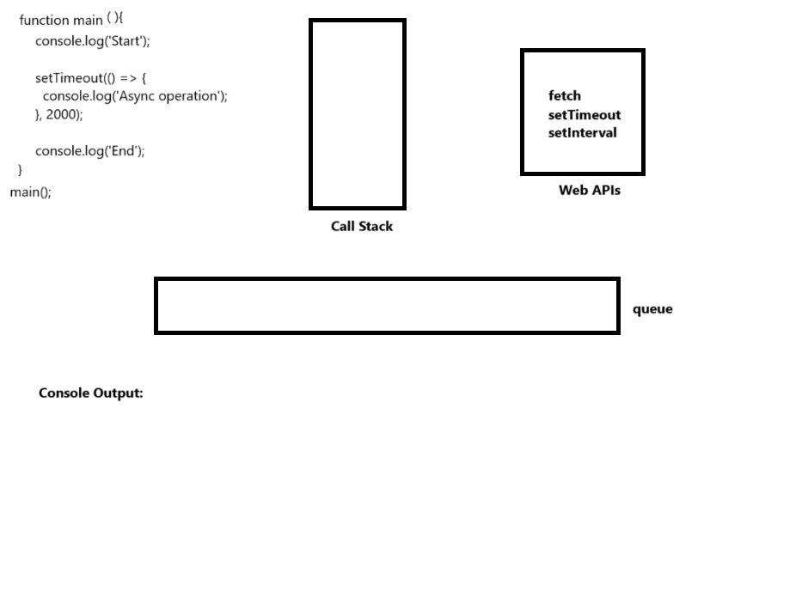
Event Loop

Slide 14
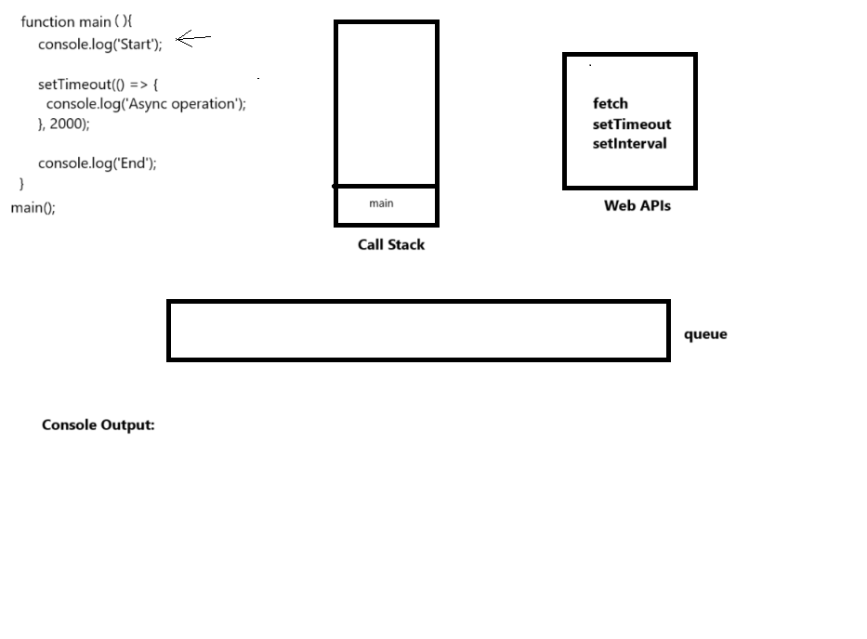
Event Loop

Slide 15
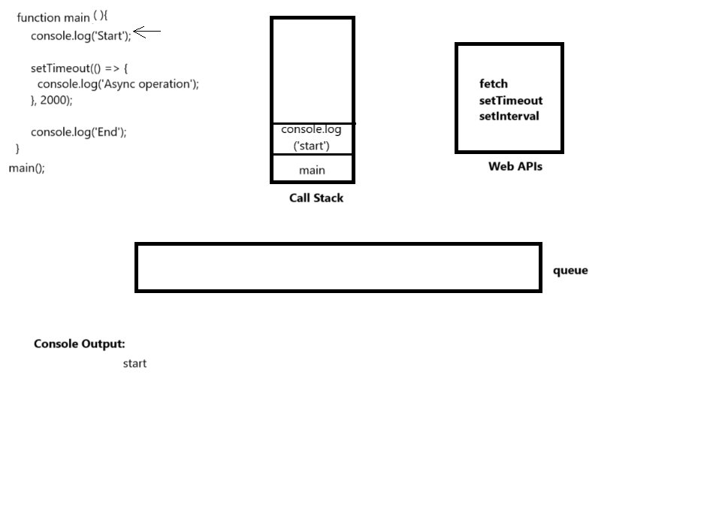
Event Loop

Slide 16

Event Loop

Slide 17
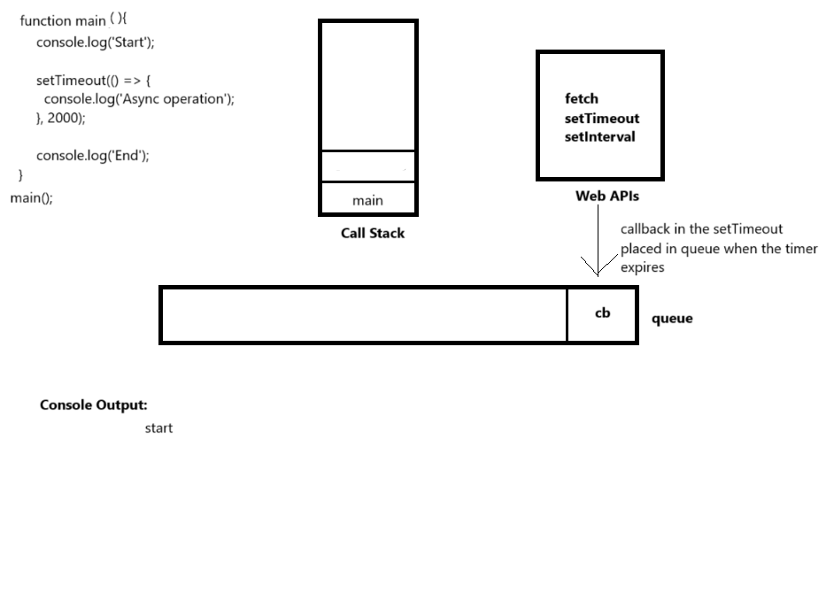
Event Loop

Slide 18
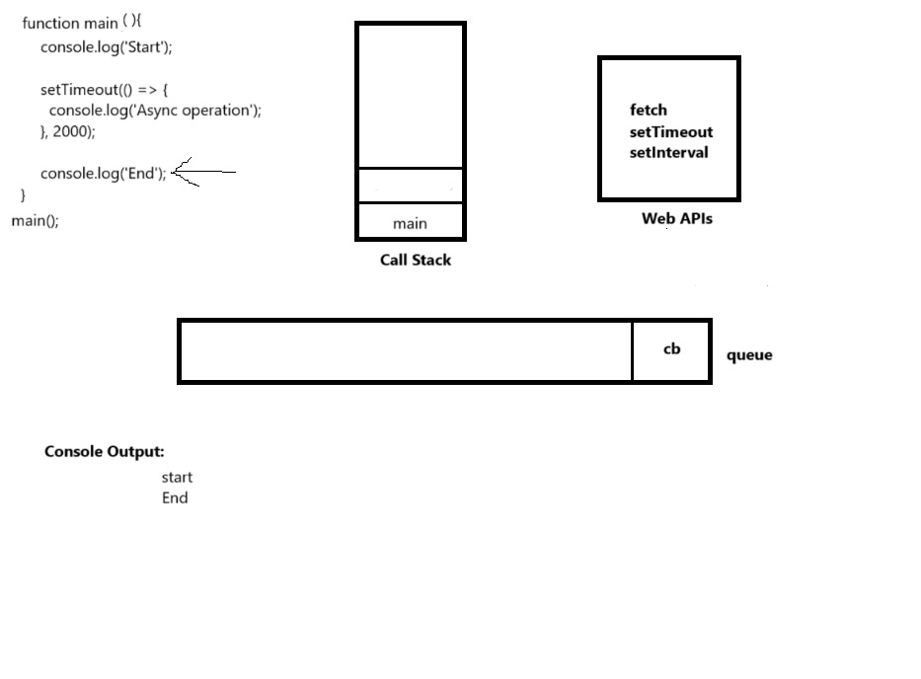
Event Loop

Slide 19
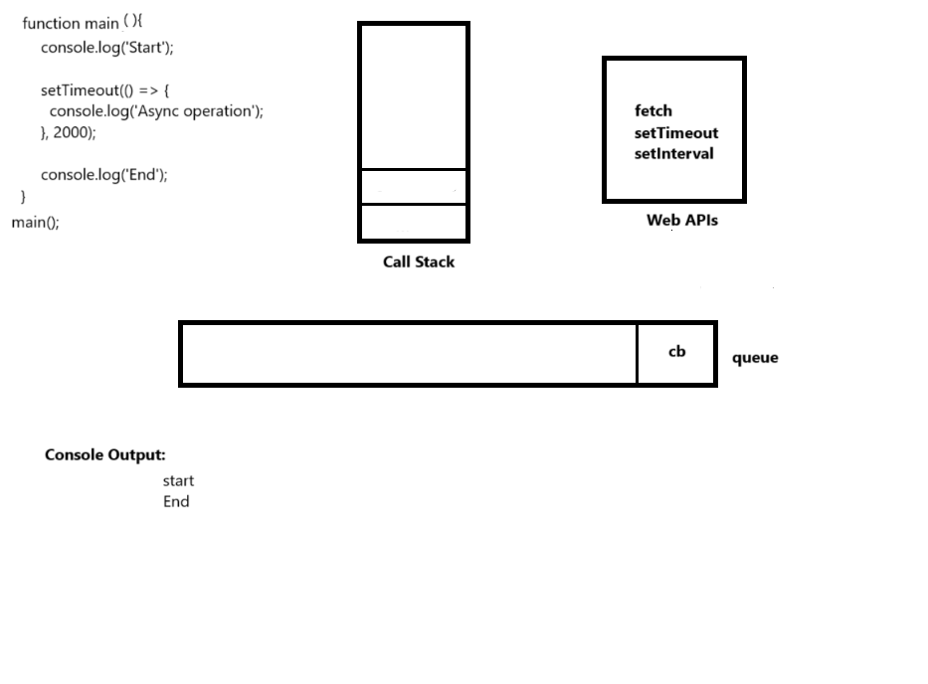
Event Loop

Slide 20
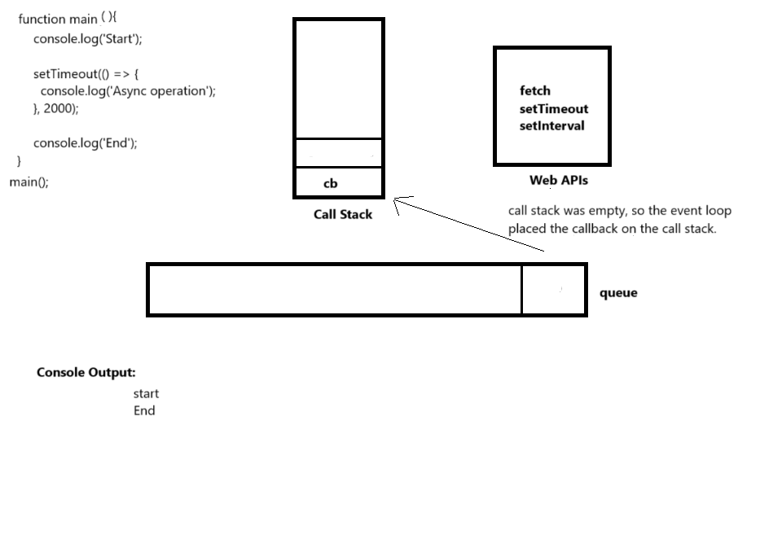
Event Loop

Slide 21
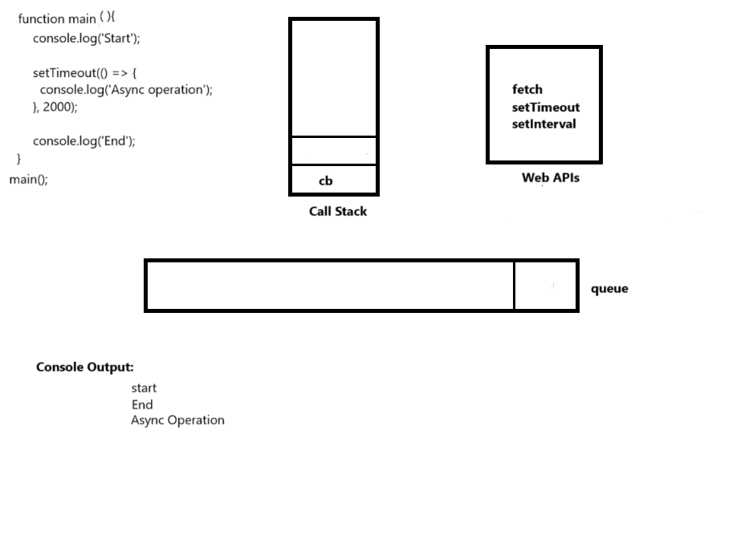
Event Loop

Slide 22
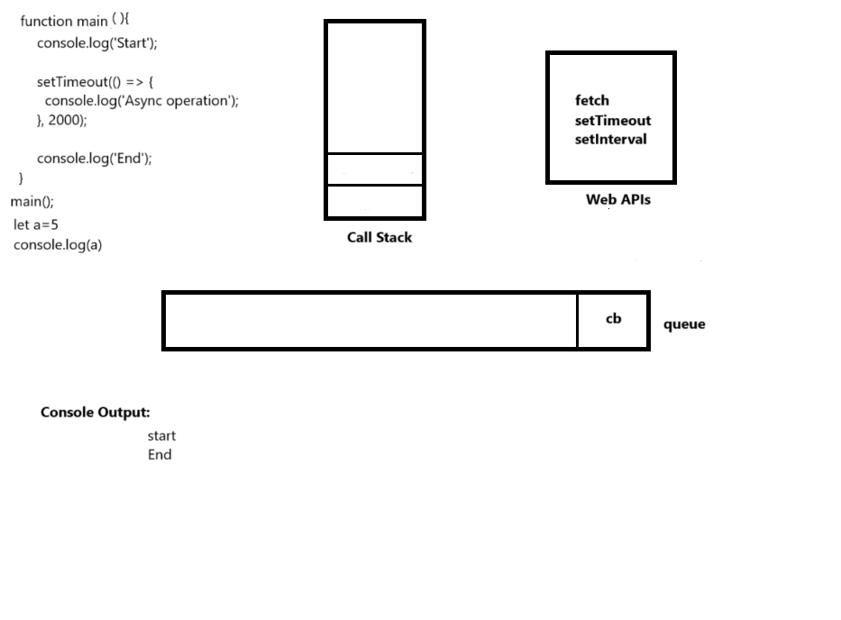
Event Loop
If there were some instructions after main function call, would cb still be placed on the call stack?

Slide 23
Event Loop
No, because when JavaScript runs for the first time, it creates a global execution context, which is placed on the call stack.
All instructions outside a function belong to this global execution context.
The global execution context remains on the stack until the entire script finishes execution.
As a result, the callback won’t be added to the call stack until the script has fully executed—including the two instructions following the main function call.

Slide 24
2 types of queues for callback
Microtask Queue (also called Job Queue)
Callback Queue (also called Task Queue or Macrotask Queue)
Microtask Queue (Job Queue)
Used for: Promises
Higher priority than the Callback Queue.
Executes immediately after synchronous code (before any tasks from the Callback Queue).
Callback Queue (Macrotask Queue)
Used for: setTimeout() setInterval()
Lower priority than the Microtask Queue.
Runs after all microtasks are cleared.

Slide 25
Micro/Callback(Macro) Queue
console.log("1: Start");
setTimeout(() => console.log("4: setTimeout"), 0); // Goes to Callback Queue
Promise.resolve().then(() => console.log("3: Promise resolved")); // Goes to Microtask Queue
console.log("2: End");
Output
1: Start
2: End
3: Promise resolved <-- Microtask runs before setTimeout
4: setTimeout

